Slide 1
Research on unemployment rate 2009-2023

Slide 2
Purpose of speech
Objective: To gain insight into the trends and factors affecting New Zealand's unemployment rate.
Audience: Tailored for government managers, business managers, economists, union representatives and the general public.
Objective: To provide a comprehensive analysis of unemployment trends relevant to policy makers and business leaders.
Discuss the effects of economic policy on employment for economists and trade union representatives.
Provide practical advice to address unemployment challenges that resonate with all stakeholders.

Slide 3
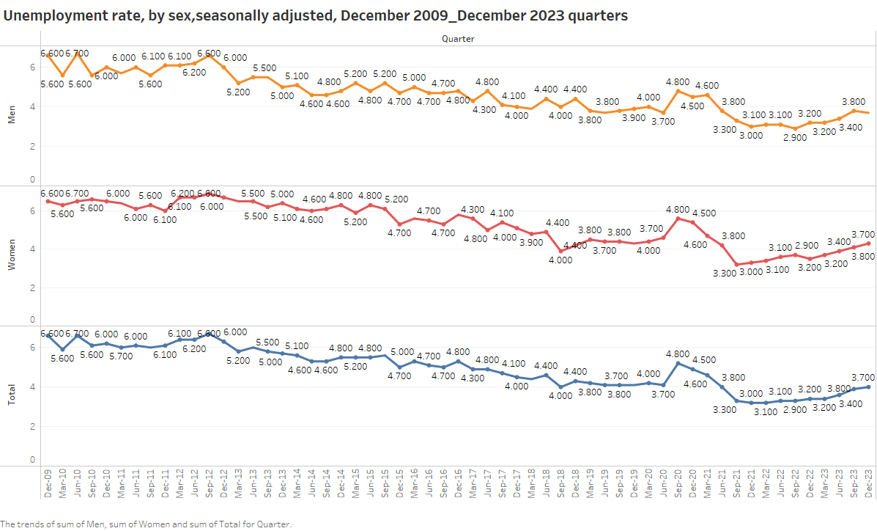
The unemployment trend is expressed as a line chart
The line chart depicts the unemployment rate in New Zealand from 2009 to 2023. Each dot on the line represents the quarterly unemployment rate, showing trends over the years. The X-axis represents the time (quarter) and the Y-axis represents the percentage of unemployment. This visualization allows the viewer to identify patterns and fluctuations in the unemployment rate over a given period
Graphic Vision 1

Slide 4
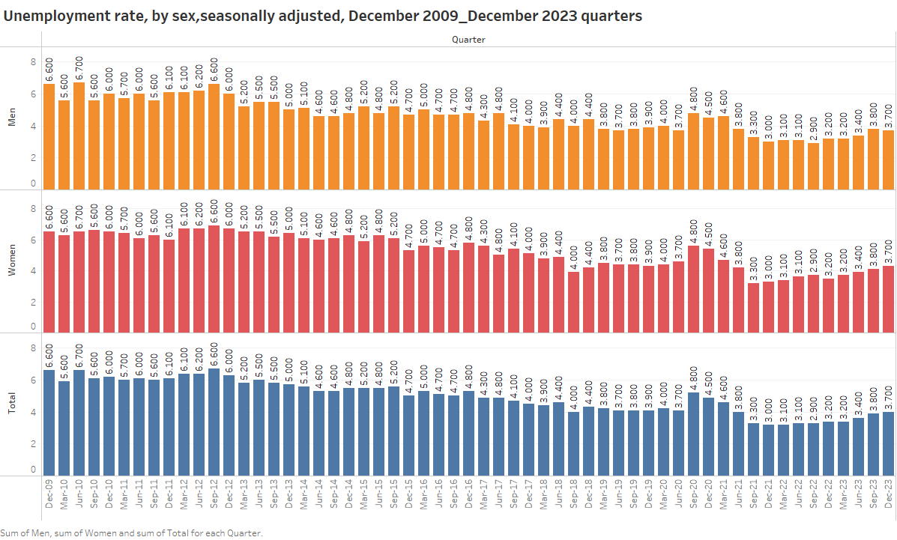
The unemployment trend is expressed as a bar chart
Although the bar chart shows the approximate number of unemployed people from 2009 to 2023, trying to understand the trend through the bar chart is less intuitive than the line chart. The height of the bar indicates the number of unemployed people in the current period and can be counted accordingly.
Graphic Vision 2

Slide 5
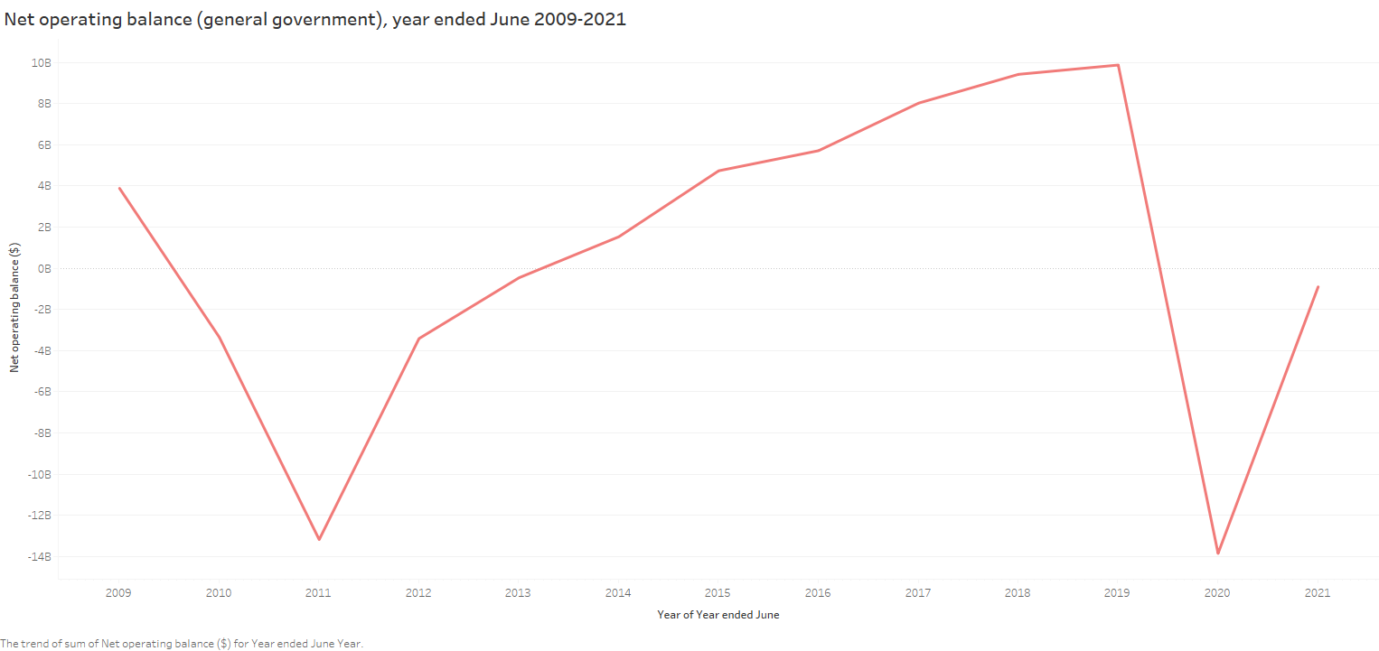
Suggestion
According to the changes in the unemployment rate and the government's policy support, some suggestions can be drawn for the government and enterprises to strengthen the promulgation of relevant policies, the mentors of enterprises, and the implementation of targeted training programs to improve the skills and employability of the workforce.
Graphic Vision 3

Slide 6
Future trend changes
Through the line chart on the right, it becomes evident that post-2020, the New Zealand government escalated its fiscal expenditure significantly. This escalation primarily aimed to address the economic and societal impacts of the pandemic, thereby steering the overall economic landscape towards a positive trajectory. It has served as a catalyst for the institutions affected by the Lockdown.
Graphic Vision 3

Slide 7
Thank you for watching
Jason Yang
1614276

